Slide 1
Pre-assessment Questions
  1. Which package defines classes that implement GUI, such as buttons, checkboxes, and comboboxes ?
    a. java.applet
    b. java.io
    c. java.awt
    d. java.net
  2. Which class of the java.lang package provides methods for converting characters from uppercase to lowercase?
    a. System
    b. Character
    c. Object
    d. Class

Slide 2
Pre-assessment Questions (Contd.)
  3. Which method returns the largest double value of the next smaller integer?
    a. floor()
    b. ceil()
    c. abs()
    d. round()
  4. Which method copies characters from a source String object into the destination character array?
    a. getChars()
    b. charAt()
    c. compareTo()
    d. length()

Slide 3
Pre-assessment Questions (Contd.)
  5. Identify the correct order of steps to be taken to create a user-defined
  package:
    Create a source file containing the package definition.
    Compile the source file.
    Create a folder having the same name as package name and save the source file within the folder.
    1, 2, 3
    1, 3, 2
    2, 3, 1
    3, 2, 1

Slide 4
Solutions to Pre-assessment
Questions
  c. java.awt
  b. Character
  a. floor()
  a. getChars()
  b. 1, 3, 2

Slide 5
Objectives
  In this lesson, you will learn about:
    Using threads in Java
    The life cycle of a thread
    Creating threads
    Identifying the thread priorities
    Thread synchronization and inter-threaded communication
    Garbage collection

Slide 6
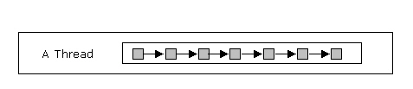
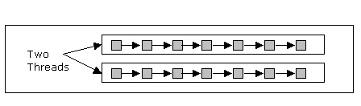
Using Threads in Java
  A thread is defined as the of execution of a program.
  For example, a Central Processing Unit (CPU) performs various tasks simultaneously, such as writing and printing a document, installing a software, and displaying the date and time on the status bar. All these processes are handled by separate threads.
  A process that is made of one thread is known as single-threaded process.
  A process that creates two or more threads is called a multithreaded process.

Slide 7
Using Threads in Java (Contd.)
  Basic Concepts of multithreading
    Multitasking is the ability to execute more than one task at the same time.
    Multitasking can be divided into two categories:
      Process-based multitasking
      Thread-based multitasking
    Benefits of multithreading
      Improved performance
      Minimized system resource usage
      Simultaneous access to multiple applications
      Program structure simplification
    Pitfalls of multithreading
      Race condition
      Deadlock condition
      Lock starvation

Slide 8
Using Threads in Java (Contd.)
  The Thread class
    The java.lang.Thread class is used to construct and access individual threads in a multithreaded application.
    The Thread class contains various methods that can obtain information about the activities of a thread, such as setting and checking the properties of a thread, causing a thread to wait, and being interrupted or destroyed.
    A few methods defined in the Thread class are:
      getPriority(): Returns the priority of a thread.
      isAlive(): Determines whether a thread is running.
      sleep(): Makes the thread to pause for a period of time.
      getName(): Returns the name of the thread.
      start(): Starts a thread by calling the run() method.
    The first thread to be executed in a multithreaded process is called the main thread. The main thread is created automatically on the start up of Java program execution.

Slide 9
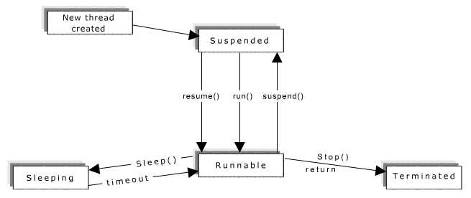
The Life-cycle of a Thread
  The various states in the life cycle of a thread are:
    New
    Runnable
    Not Runnable
    Terminated or Dead
  The following figure shows the life-cycle of a thread:

Slide 10
Creating Threads
  You can create a thread in the following ways:
    Implementing Runnable interface
    Extending the Thread class
  Creating Threads by implementing the Runnable interface
    The Runnable interface only consists of the run() method, which is executed when the thread is activated.
    When a program needs to inherit from a class other than from the Thread class, you need to implement the Runnable interface.
    The following syntax shows how to declare the run() method:
    public void run()
    You can use the following code to create a thread by implementing the Runnable interface:
      class NewThread implements Runnable
      {
      Thread t;
      NewThread()
      {

Slide 11
Creating Threads (Contd.)
t = new Thread(this, "ChildThread");
System.out.println("Child Thread:" + t);
t.start();
}
public void run()
{ // Implementing the run() method of the Runnable interface
System.out.println("Child Thread Started");
System.out.println("Exiting the child thread");
}
}
class ThreadClass
{
public static void main(String args[])
{
new NewThread();
System.out.println("Main thread Started");

Slide 12
Creating Threads (Contd.)
try
{
Thread.sleep(5000);
}
catch(InterruptedException e)
{
System.out.println("The main thread interrupted");}
System.out.println("Exiting the main thread");
}
}

Slide 13
Creating Threads (Contd.)
  Creating Threads by extending the Thread class
    The class extending the Thread class calls the start() method to begin the child thread execution.
    You can use the following code to create a thread by extending the Thread class:
    class ThreadDemo extends Thread
    {
    ThreadDemo()
    {
    super("ChildThread"); // calls the superclass constructor
    System.out.println("ChildThread:" + this);
    start();
    }

Slide 14
Creating Threads (Contd.)
public void run()
{
System.out.println("The child thread started");
System.out.println("Exiting the child thread");
}
}
class ThreadDemoClass
{
public static void main(String args[])
{
  new ThreadDemo();
  System.out.println("The main thread started");
  System.out.println("The main thread sleeping");

Slide 15
Creating Threads (Contd.)
try
{
Thread.sleep(1000);
}
catch(InterruptedException e)
{
System.out.println("The main thread interrupted");
}
System.out.println("Exiting main thread");
})

Slide 16
Creating Threads (Contd.)
Creating Multiple threads
  You can create multiple threads in a program by implementing the
  Runnable interface or extending the Thread class.
  Using the isAlive() Method
    The isAlive() method is used to check the existence of a
    thread.
    The following syntax shows how to declare the isAlive()
    method:
    public final boolean isAlive()
  Using the join() Method
    It is called the join() method because the thread calling the
    join() method waits until the specified thread joins the calling
    method.
    The following syntax shows how to declare the join() method:
    public final void join() throws InterruptedException

Slide 17
Identifying the Thread Priorities
The Java Run-time Environment executes threads based on their priority.
A CPU can execute only one thread at a time. Therefore, the threads, which are ready for execution, queue up for their turn to get executed by the processor.
A thread with higher priority runs before threads with low priority.
Defining Thread Priority
  Thread priorities are the integers in the range of 1 to 10 that specify the priority of one thread with respect to the priority of another thread.
  The threads are scheduled using fixed priority scheduling.
  The Java Run-time system selects the runnable thread with the highest priority of execution when a number of threads get ready to execute.
Setting the Thread Priority
  You can set the thread priority after it is created using the setPriority() method declared in the Thread class.
  The following syntax shows how to declare the setPriority() method:
  public final void setPriority(int newPriority)

Slide 18
Thread Synchronization and
Interthread Communication
  When two threads need to share data, you must ensure that one thread does not change the data used by the other thread.
  Synchronizing Threads
    Synchronization of threads ensures that if two or more threads need to access a shared resource then that resource is used by only one thread at a time.
    Synchronization is based on the concept of monitor.
    The monitor controls the way in which synchronized methods access an object or class.
    To enter an object’s monitor, you need to call a synchronized method.
    When a thread calls the wait() method, it temporarily releases the locks that it holds. In addition, the thread stops running and is added to the list of waiting threads for that object.

Slide 19
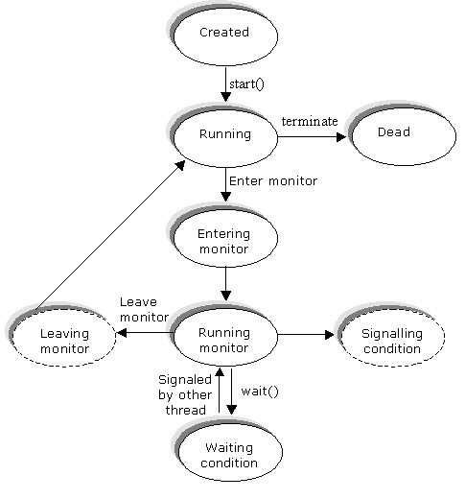
Thread Synchronization and
Interthread Communication (Contd.)
The following figure shows the synchronization of threads:

Slide 20
Thread Synchronization and
Interthread Communication (Contd.)
  Communication Across Threads
    A thread may notify another thread that the task has been completed. This communication between threads is known as interthread communication.
    The various methods used in interthread communication are:
      wait()
      notify()
      notifyAll()

Slide 21
Garbage Collection
  Garbage collection is the feature of Java that helps to automatically destroy the objects created and release their memory for future reallocation.
  The various activities involved in garbage collection are:
    Monitoring the objects used by a program and determining when they are not in use.
    Destroying objects that are no more in use and reclaiming their resources, such as memory space.
    The Java Virtual machine (JVM) acts as the garbage collector that keeps a track of the memory allocated to various objects and the objects being referenced.
    The various methods of the Runtime class used in memory management are:
      static Runtime getRuntime(): Returns the current runtime object.
      void gc(): Invokes garbage collection.
      long totalMemory(): Returns the total number of bytes of memory available in JVM.

Slide 22
Demonstration-Implementing Threads in Java
  Problem Statement
    The current date and time has to be displayed on the status bar of the Applicant’s details applet.
  Solution
    The Java application is created that displays the current date and time on the status bar of an applet.
    To solve the above problem, perform the following tasks:
      Create the code and the html file for the application.
      Compile and execute the application.

Slide 23
Summary
In this lesson, you learned:
  A thread is defined as the path of execution of a program. It is a sequence of instructions that is executed to define a unique flow of control.
  A program that creates two or more threads is called a multithreaded program.
  The two types of multitasking are:
    Process-based
    Thread-based
  The various advantages of multithreading are:
    Improved Performance
    Minimized System Resources Usage
    Simultaneous access to multiple applications

Slide 24
Summary (Contd.)
  The various disadvantages of multithreading are:
    Race condition
    Deadlock
    Lock starvation
  The java.lang.Thread class is used to construct and access individual threads in a multithreaded application.
  The various states in the life cycle of a thread are:
    New
    Runnable
    Not Runnable
    Terminated or Dead
  You can create a thread in the following ways:
    Implementing Runnable interface
    Extending the Thread class

Slide 25
Summary(Contd.)
  Thread priorities are the integers in the range of 1 to 10 that specify the priority of one thread with respect to the priority of another thread.
  You can set the thread priority after it is created using the setPriority() method declared in the Thread class.
  Synchronization of threads ensures that if two or more threads need to access a shared resource, the resource is used by only one thread at a time.
  Various threads can communicate with each other using the following methods:
    wait()
    notify()
    notifyAll()
  Garbage collection is the feature of Java that helps to automatically destroy the objects created and release their memory for future reallocation.

